Slide 1
Binary Brain Classifier
01

Slide 2
Architecture
Binary Brain Slice Classifier · Human vs Mouse
Input
Backbone
Head
Output
224×224 RGB
(grayscale→3ch)
▶
EfficientNet-B0
(pretrained, ImageNet)
▶
Dropout(0.3) → Linear(64) → ReLU → Linear(1)
▶
Sigmoid → Binary
(Human / Mouse)
Training strategy
Optimiser
Loss
Data augmentation
Head-only first (5 epochs)
then unfreeze top-6 backbone blocks
Adam · lr 1e-3 → 1e-5
ReduceLROnPlateau (patience 3)
BCEWithLogitsLoss
Flip · Rotate 180° · ColorJitter
GaussianBlur
01

Slide 3
Metrics
Test set evaluation
0.9909
0.9900
0.9918
0.9909
0.9991
Accuracy
Precision
Recall
F1-Score
ROC-AUC
0.9891
0.0391
0.0083
PR-AUC
Log Loss
Brier Score
Per-axis accuracy
Axis | Accuracy | Images
Coronal | 0.9924 | ~33%
Sagittal | 0.9897 | ~33%
Axial | 0.9906 | ~33%
Threshold = 0.5 · 0 = Human · 1 = Mouse
02

Slide 4
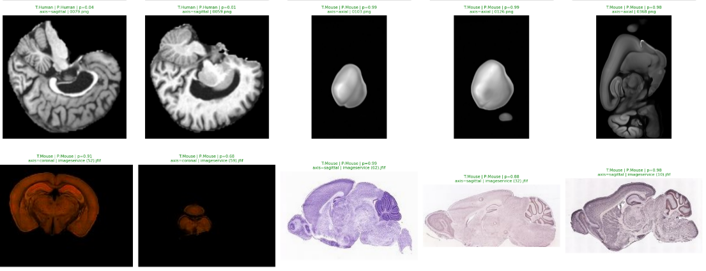
Sample Results
Prediction grid — human and mouse brain slice examples
03

